Slide 1


Recent Course-Topics in MIS Predictive Analytics
2020
Vince Davis
– Alberta School of Business
Nhuan To (Research Assistant, Statistics Consultation, Tech Support)
– Graduate Teaching Assistantship, University of Alberta
Sponsored by Accounting, Operations and Information Systems (AOIS) Department
Alberta School of Business, UofA

Slide 2
How organizations could use this technology:
Analytics can help improve all your Processes
From Analytics:
use Findings/Predictions to better:
-Categorize input-cases
-Assess the Status of an input-case
-Improve Algorithms in computer programs
-Support/replace human judgement/actions
- ie.
-Move towards a more digital enterprise
G
B
E’
Bought
Software
Package
L
built
K
built
A
built
N
D
I’
Rented
Web-
Service
=Human
Procedure
M
C
=Computerized
Procedure
=Human
Procedure
=Human
Decision
Vince Davis – Alberta School of Business

Slide 3
Layers of Analysis: Strategic vs Logical vs Physical
Logical (aka Generalized)
independent
independent
Strategic (aka Conceptual)
Physical (aka Technical)
“Just Do It”

Slide 4
Applying “Layers of Analysis” to Job-titles at Borealis AI / Royal Bank
Logical (aka Abstracted)
Data Scientist:
-Algorithms
-Math / Statistics
-Signal to Noise ratio
-Operations Mgt depth
independent
independent
Strategic (aka Conceptual)
Data Analyst:
-Identify value of data
-Initiate / scope project
-Sponsor funding
-Direct “Success Criteria”
Physical (aka Technical)
Data Engineer:
-Gather many data sources
-Extract/Clean/Transform
-Join tables/data-streams
-Load and present data
“Just Do It”
Vince Davis – Alberta School of Business

Slide 5
Applying “Layers of Analysis” to Job-titles at Borealis AI / Royal Bank
OM
80%
Data Scientist
20%
10%
10%
MIS
Data Analyst
Data Engineer
40%
40%

Slide 6
Course-Topics in MIS Predictive Analytics:
MIS / OM / CMPUT courses available to BComm Students:
MIS415: Databases: SQL, Data-Modeling, Func/Proc/Trig, App-interface, Phys, DBA
MIS413: Sys Analysis: Process Modeling, Requirements, Design, SDLC
MIS418: Ecommerce: Business Models, Mktg, Web-architectures, apps (Python)
MIS412: Mgt Supprt Sys: SQL Nav, Optim-Models, Desc/Predict, AI/ML, (Python)
OM352: Oprtns Mgt: Modeling/ Simple Algorithms (Excel)
OM420: Predictive BusAnalytics: Statistics, Models, Prep, Tools (R)
OM471: Decis Supprt Sys: Modelling, App-design (Excel, VBA)
CMPUTxxx: Programming (w. Python), Logic, Algorithms, Databases, AI/ Machine-Learning
UofA is creating a Bcomm undergrad Specialization in Business Analytics,
which may included courses such as MIS412, OM352, OM420, MIS415, etc
Vince Davis – Alberta School of Business

Slide 7
Course-Topics in MIS Predictive Analytics:
MIS412: Managerial Support Systems 1. Descriptive Analytics (w. hands-on Asgn A):
Review: Navigation of Relational Data Models (SQL): Join, Group By, View
Optimizing Models: Snowflakes, Stars, Large-Central-Tables (eg. Csv)
OLAP: Pivot-Tables: Summarize, Slice, Drill-down, Cross-tab, Pivot
Tableau: (equivalent Join, View, Pivot-Tables Summarize, Cross-tab) Graphic Display
Python Dataframe: (provided equivalent SQL, Pivot, Cross-tab, Graphic Display)
2. Predictive Analytics (w. hands-on Asgn B & C):
SQL Data-Prep: View, Join, Group By, Add Columns: Summaries, Bins
Python Data-Prep: Datatypes, Bins, Handle Nulls/ Outliers/ High# Distinct/Unique
Mining Algs: Decision-Tree, Bayes, Cluster, Neural Net-ML: Split/ Train/ Test/ Apply
Tools: MS-SSDT-client, MS-Azure-cloud, WeKa, DataBricks-cloud
Tools: Python: Neural Net-prep: Datatype,Scale,Sklearn-canned,TensorFlow-custom
3. Other Managerial Support Systems topics (w. Asgns C&D):
Text Mining / Web Mining
Knowledge Mgt (KM)
Group (Decision) Support Systems
Expert Systems / Recommenders
Robotics
Big Data/ IOT/ Map Reduce-Hadoop
Vince Davis – Alberta School of Business

Slide 8
1.2 Optimizing Models: Snowflakes, Stars, Large-Central-Tables (eg. Csv):
A “Snowflake” structure is optimized from a regular data-model:
From regular data-model, choose table as “Centre” of Star-structure (eg. Sales-Fact).
Include any “parents”, “grandparents”, etc tables. Remove any other (“Fan-Trap”) tables.
Pre-Join (de-normalize) “grandparent”, “great-grandparent” etc tables into Parent-table as views
This structure allows selection of centre-alone, or selectively joined to one or more views
Further, all “parent” tables could be joined to the centre to produce one Large-Central-Table
Store_V
Store_Key
Name
City
Region
FloorPlanType
Product_V
Product_Key
Description
Product_type
Brand
Age_category
Sales-Fact (87,489)
Store_Key
Product_Key
Times_Key
TableD_Key
TableE_Key
Sales
Cost
Profit
TableD_V
TableD_Key
ccccccc
ddddddd
Times_V
Times_Key
Time_date
Day_of_week
wwwwwww
TableE_V
TableE_Key
vvvvvvvv
Vince Davis – Alberta School of Business

Slide 9
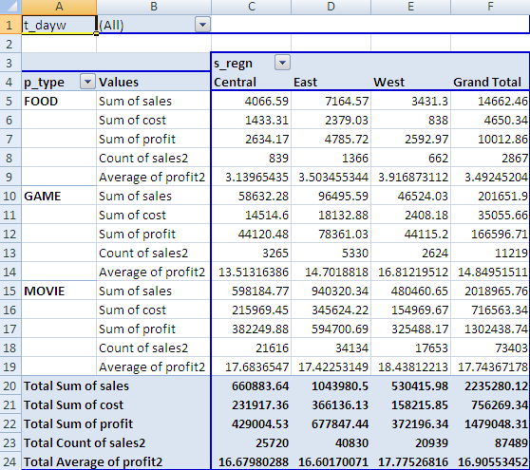
1.3 OLAP: Pivot-Tables: Summarize, Slice, Drill-down, Cross-tab, Pivot
SQL can be used to Group-Summarize and produce Sums, Counts, Avgs, etc
Pivot-tables (eg. In Excel) can do the same: also sub-totals, totals, & pivots
select substring(s.region,1,7) as s_regn, substring(p.product_type,1,5) as p_type,
sum(sf.sales) sum_sales, sum(sf.cost) sum_cost, sum(sf.profit) sum_profit,
count(sf.sales) count_sales, avg(sf.profit) avg_profit
from sales_fact sf, product p, store s, times t
where sf.time_key=t.time_key and sf.product_key=p.product_key and sf.store_key=s.store_key
group by substring(s.region,1,7),substring(p.product_type,1,5)
order by substring(s.region,1,7),substring(p.product_type,1,5);
SQL ------->
SQL
RESULT ------->
S_REGN P_TYP SUM_SALES SUM_COST SUM_PROFIT COUNT_SALES AVG_PROFIT
------- ----- ------------- ------------ -------------- --------------- --------------
Central FOOD 4066.59 1433.31 2634.17 839 3.13965435
Central GAME 58632.28 14514.6 44120.48 3265 13.5131639
Central MOVIE 598184.77 215969.45 382249.88 21616 17.6836547
East FOOD 7164.57 2379.03 4785.72 1366 3.50345534
East GAME 96495.59 18132.88 78361.03 5330 14.7018818
East MOVIE 940320.34 345624.22 594700.69 34134 17.4225315
West FOOD 3431.3 838 2592.97 662 3.91687311
West GAME 46524.03 2408.18 44115.2 2624 16.8121951
West MOVIE 480460.65 154969.67 325488.17 17653 18.4381221
EXCEL
PIVOT
TABLE ------->
Also:
can “pivot” (swap)
S_regn out and
T_dayw in:
Then Groups by
P_type & Tdayw
Vince Davis – Alberta School of Business

Slide 10
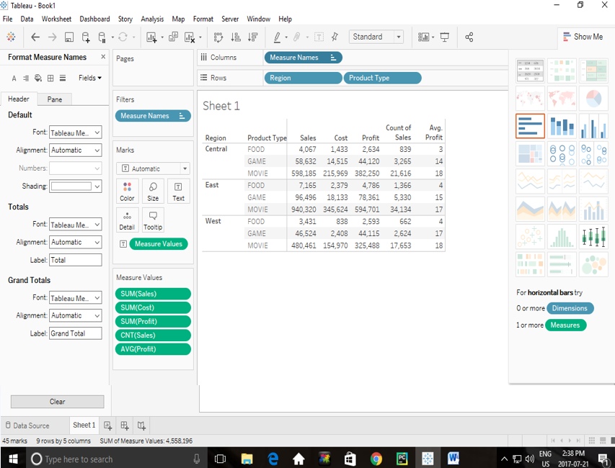
1.4 Tableau: (equivalent Join, View, Pivot-Tables Summarize, Cross-tab) Graphic Display
Tableau can duplicate SQL/Pivot table functions, plus provide Graphics:
Vince Davis – Alberta School of Business

Slide 11
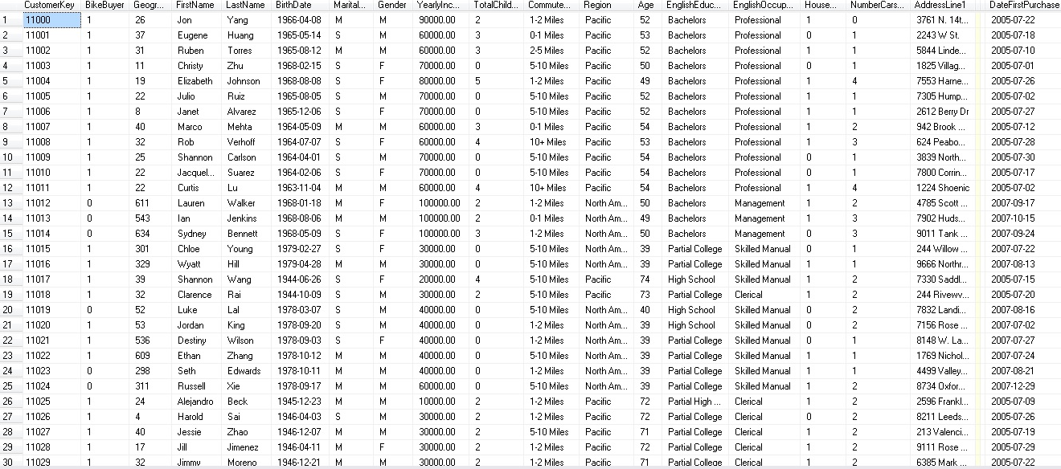
For further analysis: What Data will we use? Microsoft vTargetMail:
1st data set: = “Known”
vTargetMail table = historical data about 18,484 customers
Each customer record (row) has many attributes (facts about each customer):
#1: CustomerKey attribute holds each customer’s unique Customer ID number
#2: BikeBuyer attribute = Target-attribute, 1=target-value
Can we use vTargetMail customers (Bike-Buyer is KNOWN) to predict whether
specific ProspectiveBuyer (similar table: Bike-Buyer is UNKNOWN) customers would be likely to buy a bike?
Vince Davis – Alberta School of Business

Slide 12
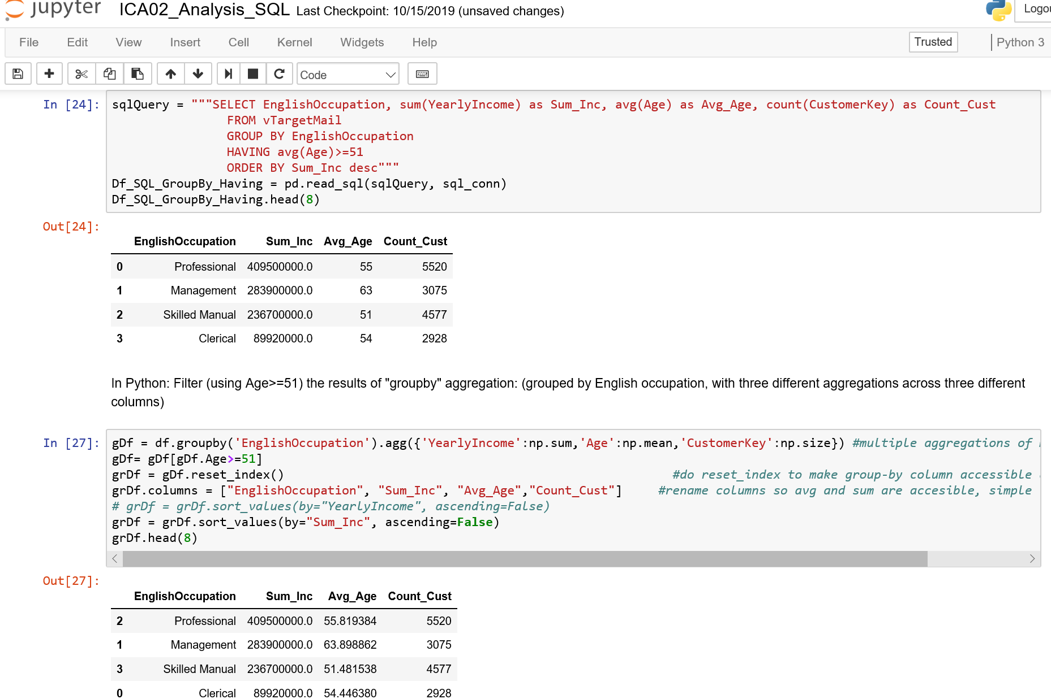
1.5 Python Dataframe: (provides equivalent SQL, Pivot, Cross-tab, Graphic Display)
Selection & Projection & Order By (in both SQL and Python)
Union (in both SQL and Python)
Group by and Having (in both SQL and Python)
Join (in both SQL and Python)
1) Install Anaconda3 (eg. https://www.anaconda.com/distribution/), 2) Start Anaconda/Jupyter Notebooks, 3) Copy .ipynb files into C:\users\yourID, 4) On “Home” page, start notebook (eg. ICA02_Analysis_SQL):
For printout of run, see ICA02_Analysis_SQL.html
Vince Davis – Alberta School of Business

Slide 13
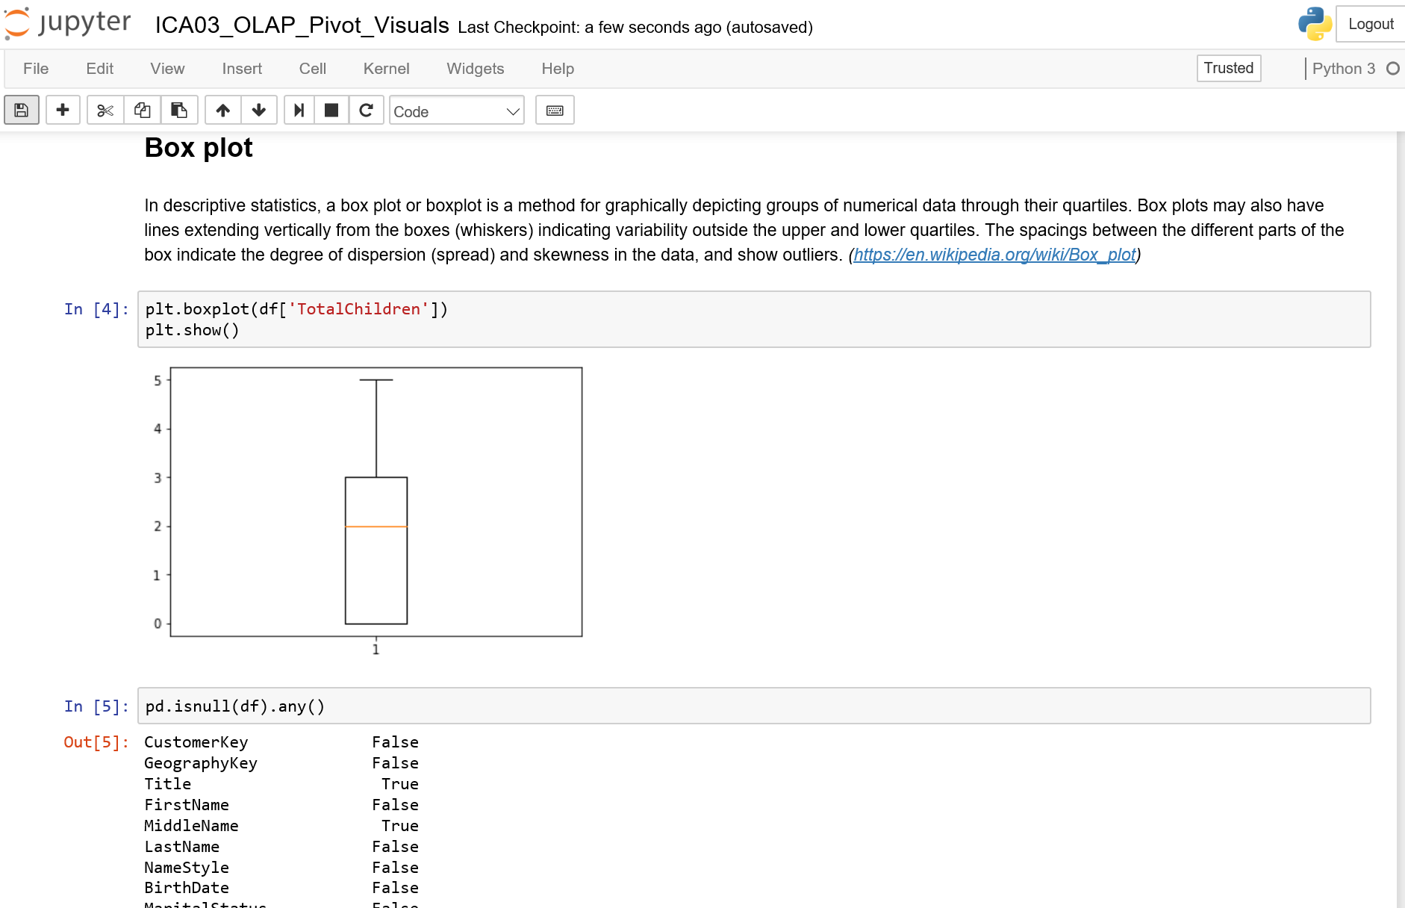
1.5 Python Dataframe: (provides equivalent SQL, Pivot, Cross-tab, Graphic Display)
Histogram plots / Box plots
Pivot table / Crosstab
1) On “Home” page, start notebook (eg. ICA03_OLAP_Pivot_Visuals):
For printout of run, see ICA03_OLAP_Pivot_Visuals.html
Vince Davis – Alberta School of Business

Slide 14
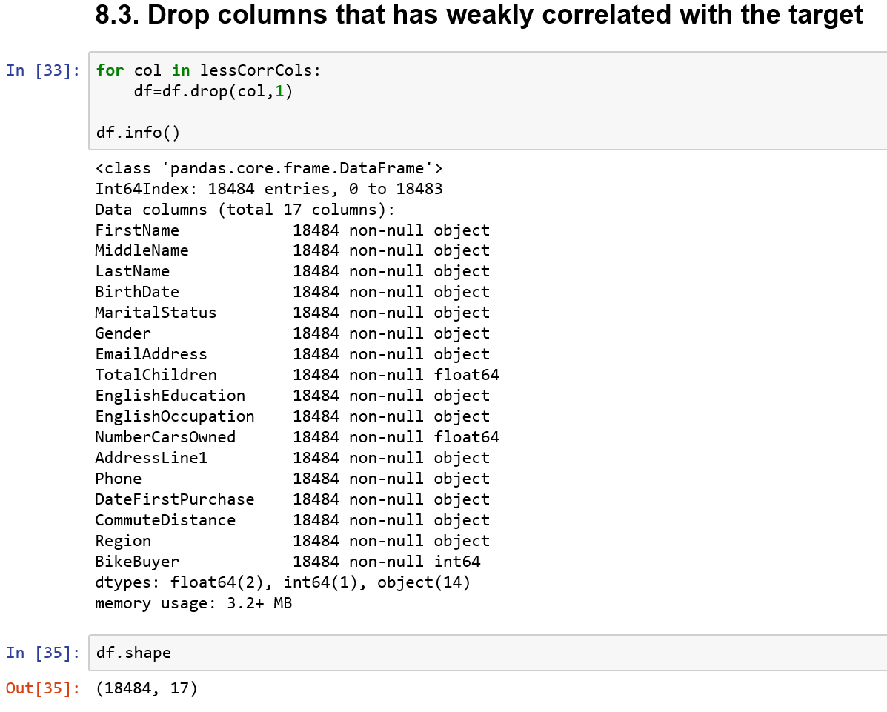
2.2 Python Data-Prep: Datatypes, Bins, Handle Nulls/ Outliers/ High# Distinct/Unique
Convert datatypes and data values
Data Binning
Remove columns with high % of missing values
Remove rows with missing value in target column
Replace outlier-values with mean column value
Replace missing-values with most-frequent value
Remove weakly correlated columns
Drop columns with too high %unique or #distinct
Convert target-column values to binary/numeric
Run Notebook: (ICA04_PreProcessingCsvForAzureWeka_template01):
For printout of run, see ICA04_PreProcessingCsvForAzureWeka_template01.html
Vince Davis – Alberta School of Business

Slide 15
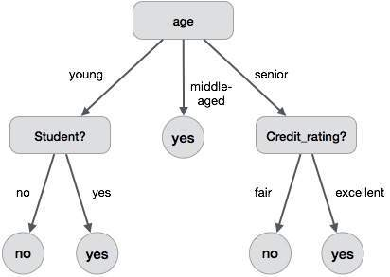
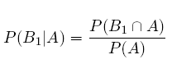
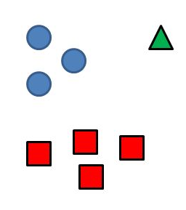
2.3 Mining Algs: Decision-Tree, Bayes, Cluster, Neural Net-ML: Split/ Train/ Test/ Apply
Choose the mining algorithm (ie, "Mining Algorithm/Technique")
Decision-Tree Naive Bayes Clustering
Can we create a progressive “tree” of value-driven decisions that lead to correct predictions? (Note: subsequent decisions on one side of a branch need not match decisions of other side.)
Algorithms for this exist
(eg. C4.5, J48)
Probability of B1 “Given” A = Probability of B1 “And” A
divided by Probability of A
(Prob of BikeBuyer=Y Given Cars=2
= Prob of BikeBuyer=Y And Cars=2
/ Prob of Cars=2)
Calculate last two terms from table data: then calculate first term from them!
Can we “cluster” groups of rows together where the “sum of the gaps between them” are minimized? Can we then calculate prediction-probabilities for each group?
(Note: this “sum” is calculated across all attributes)
Vince Davis – Alberta School of Business

Slide 16
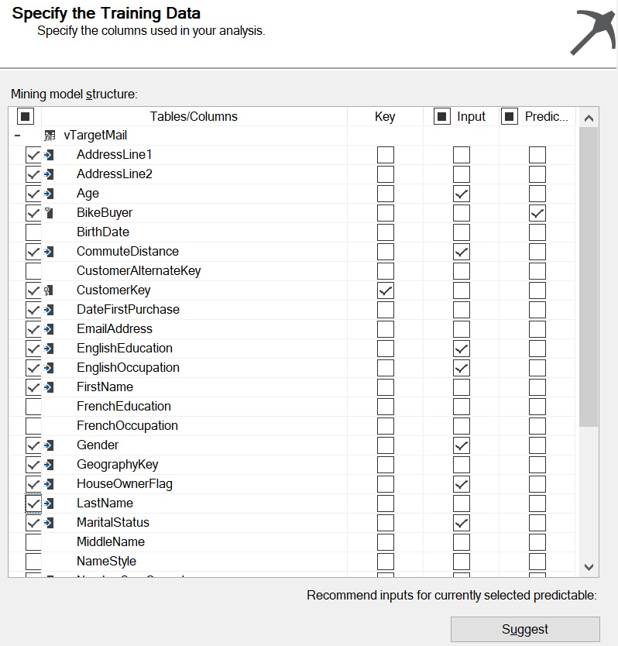
2.4 Data Mining STEPS (Using MS-SSDT-client)
Select the Key, Target, Input (used to base predictions on)
and Other columns
If in doubt about whether an attribute will be useful as “Input”, then include it anyway:
if it is of little/no use, SSDT will detect this and exclude it for building/ training of model
If unsure re:
which attributes have high predictive power, hit “Suggest”
Vince Davis – Alberta School of Business

Slide 17
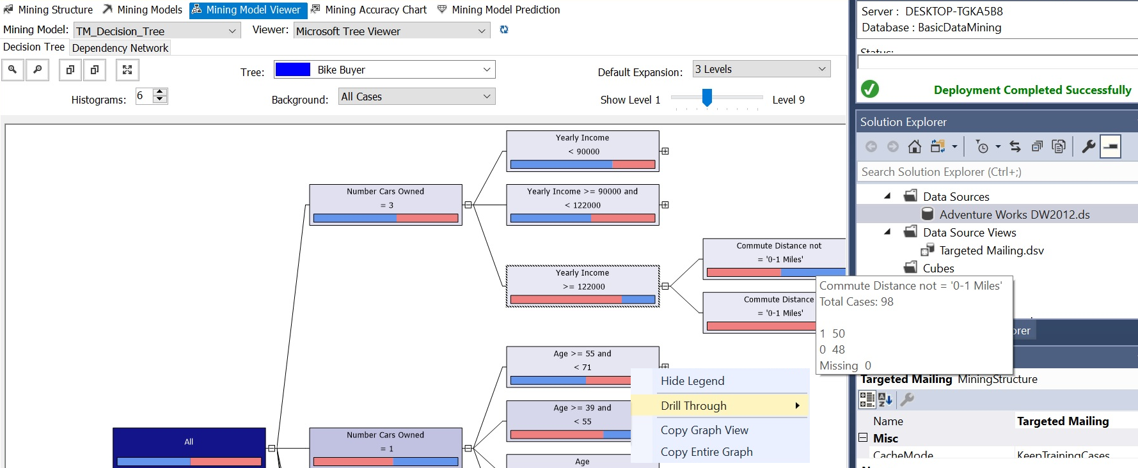
2.4 Data Mining STEPS (Using MS-SSDT-client)
Use "Build" dataset to Build (Train) all predicting-Models
Explore your Built/Trained models using “Model Viewer”:
Tree-Viewer shows Decision-Tree with values at each branch (note: different questions on each branch)
-Also: Hover-over shows Total Cases volume and volume-by-value.
-Also: Drill-through can show detailed data-rows with all attribute values
Vince Davis – Alberta School of Business

Slide 18
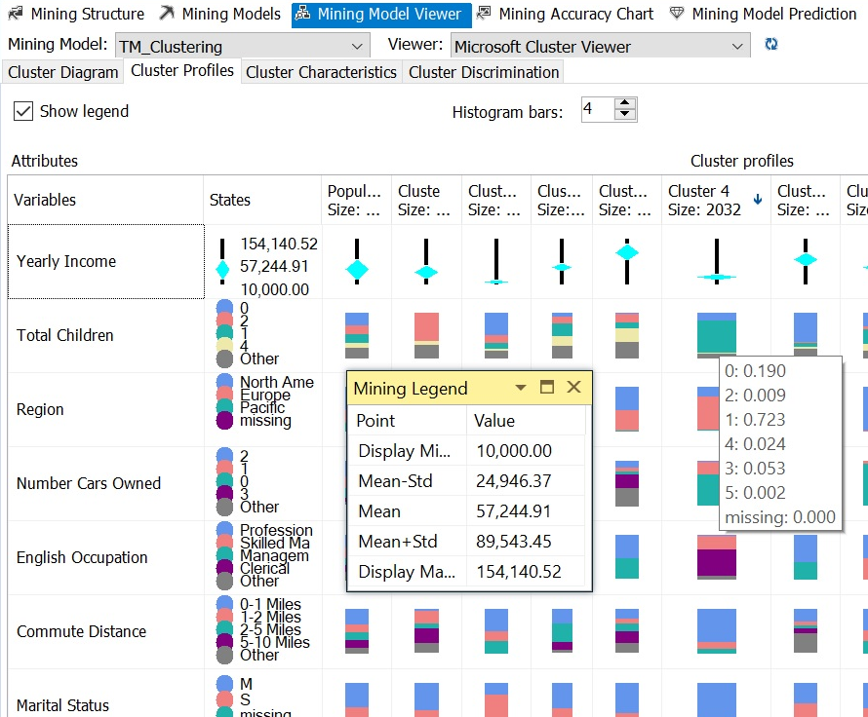
2.4 Data Mining STEPS (Using MS-SSDT-client)
Use "Build" dataset to Build (Train) all predicting-Models
Show the composition of each cluster:
Cluster-Viewer shows Cluster Profiles with each cluster (high density cluster 4 expanded above)
- for a chosen cluster: the % composition for an attribute (seen by hovering) is the % breakdown for each value
(eg. Above: the Total Children values = 1 for Cluster 4 are .723 (=72.3%) (ie, single-child families)
-for a chosen attribute (eg. Yearly Income), the Mining Legend (hover) box shows statistics
(eg. Mean=$57.24K overall: statistics can also be seen for each individual cluster)
Vince Davis – Alberta School of Business

Slide 19
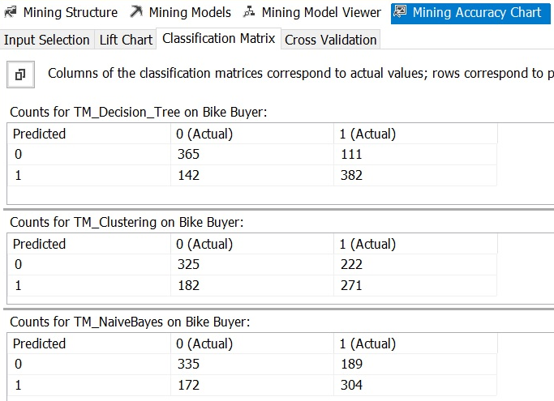
2.4 Data Mining STEPS (Using MS-SSDT-client)
Use independent "Test" dataset to Test (and score) ALL models
Accuracy: Investigate each model’s “Confusion Matrix” (matrix total= test size = 1000)
SSDT: called “Classification Matrix”
Predict=0; Actual=0 (True Neg)
Predict=0; Actual=1 (False Neg)
Predict=1; Actual=1 (True Pos)
Predict=1; Actual=0 (False Pos)
Accuracy= True Neg+True Pos
Decision Tree=365+382=747/1000 = 74.7%
Clustering =325+271=596/1000 = 59.6%
Naïve Bayes =335+304=639/1000 = 63.9%
Winner = Decision Tree !!
For this Test set of data (1000)
Trained by this Build/Train set (17,434)
Vince Davis – Alberta School of Business

Slide 20
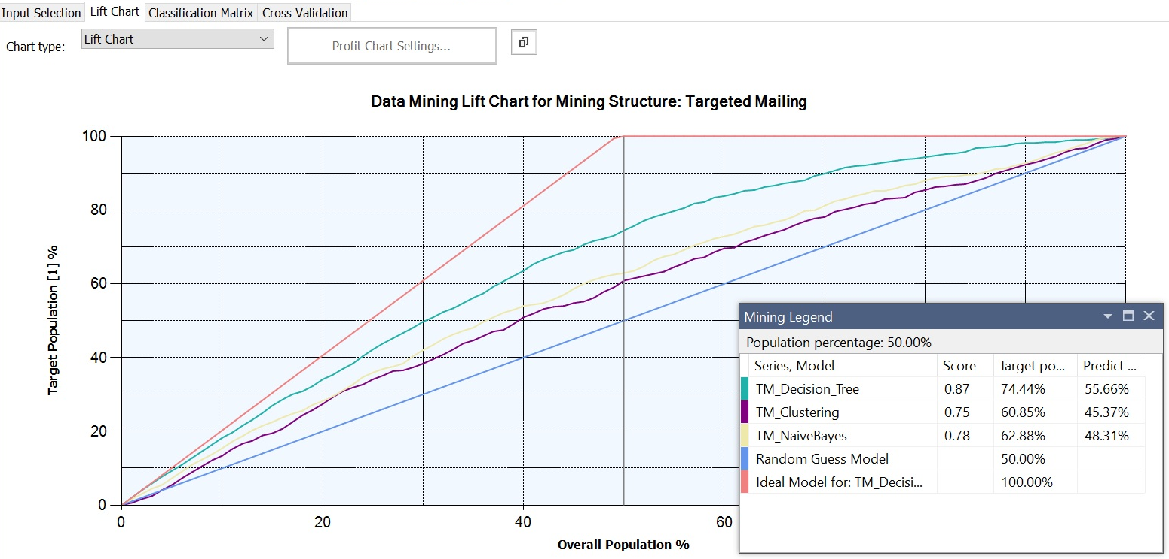
2.4 Data Mining STEPS (Using MS-SSDT-client)
Use independent "Test" dataset to Test (and score) ALL models
Mining “Lift”: Investigate each model’s “Lift” (How “easily” can I find the “True Pos” within the “True”)
Decision-Tree model predicted Bike-Buyer=1 at total of 524 times (=382+142) in the Test set (1000)
-In these 524 “Positive” predictions, there were 142 False Pos (where actual data was BikeBuyer=0)
Assume that we sort the predictions by the Probability (confidence) that Bike-Buyer=1 in descending order.
Graph above shows: if I consider the “Top 40%” of these 524 positive predictions, I get 62% of the 382 true-pos.
-In other words: if I had sent catalogues to Top 40% of predictions, I would have reached 62% of Bike-Buyers!!
-Also: if I had sent catalogues to Top 70% of predictions, I would have reached 90% of Bike-Buyers!!
The Decision-Tree “Lift Curve” (Green) is higher (superior) to the Lift Curves for Clustering (Purple) and Naïve Bayes (Yellow).
Vince Davis – Alberta School of Business

Slide 21
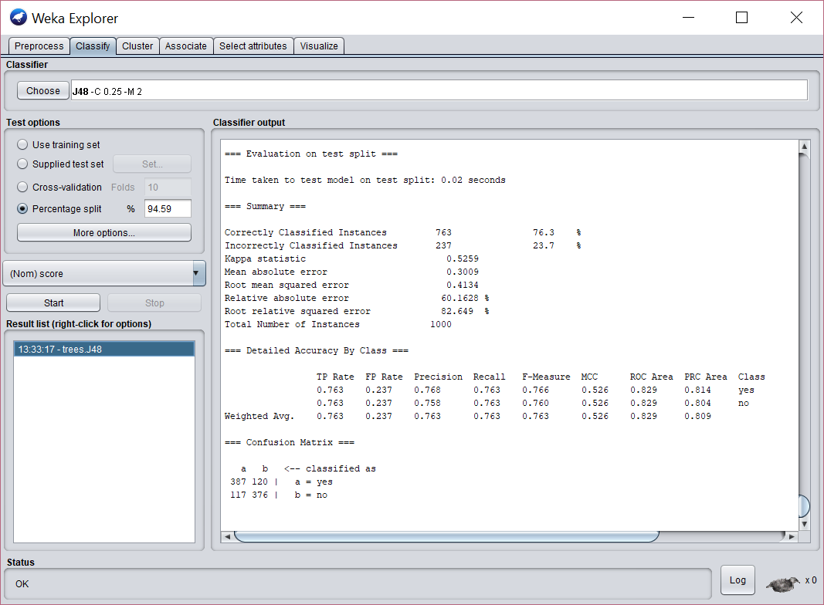
2.4 Data Mining STEPS Using WEKA (free download Client)
Do extra steps to create last “score” column with “yes/no” instead of 1/0.
Open WEKA: Under Preprocess, open file, select and remove “bad” columns
Under Classify, Choose algorithm (eg. Trees/J48), choose % split, hit “Start”
Vince Davis – Alberta School of Business

Slide 22
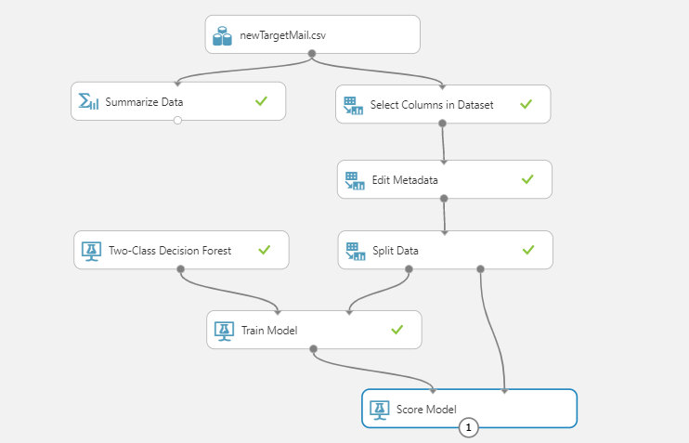
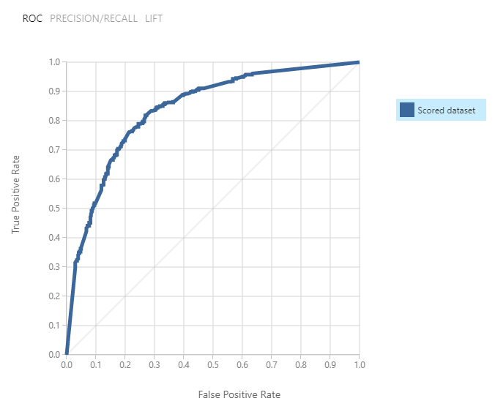
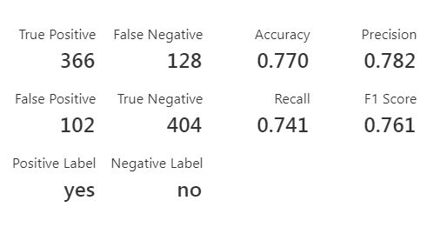
2.4 Data Mining STEPS Using MS-AZURE (CLOUD)
Create acct / sign-in at: https://studio.azureml.net/ - search/drag as in picture:
Split a “Train” & "Test" dataset to Test (ie Score) ALL models
Accuracy: Investigate each model’s “Confusion Matrix” (matrix total= test size = 1000)
Vince Davis – Alberta School of Business

Slide 23
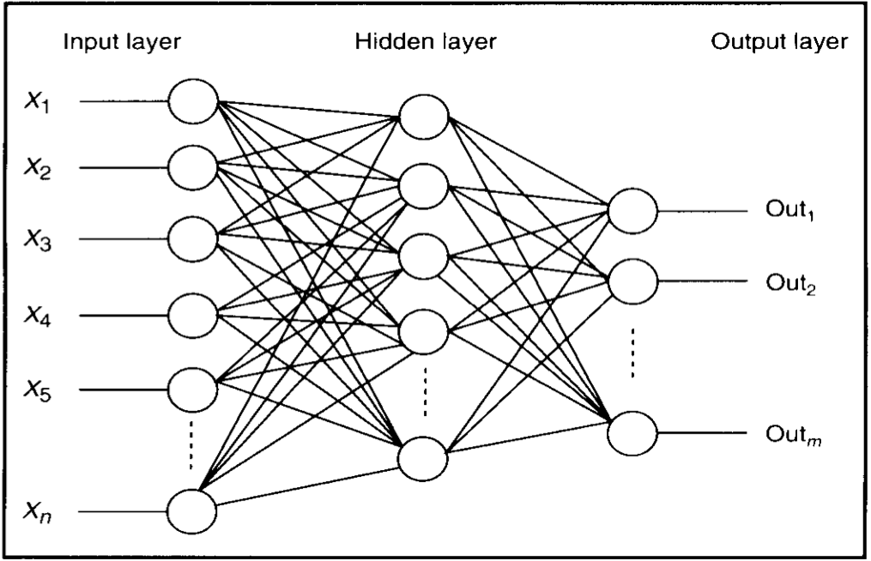
Prediction: How AI Neural Nets work:
Neural Nets trained using Back Propagation
Neural Nets: a innovation in programming
Traditional programming used inputs and policy-expectations-for-output:
-Needed clever programmers to “Program” processor how to create outputs from inputs
Neural Net programming uses inputs and sample-outputs to “Train” the processor
-Initially, the numeric values which weight the inputs for each processor are random
-For each case (sample data-row), the weightings are adjusted to address that case
-After many sample cases, the weightings hopefully give correct outputs for all cases
-Using the feedback (from correct-outputs in sample-cases) to change weightings is “Back Propagation”
-A “neuron” is a processor.
-Initially, each can be connected to all others: weightings of 0 “cut connection”.
-In theory, each operates simultaneously and has its own power supply.
-Nets are often simulated by serial CPUs, but new parallel chips are coming! IBM/Modha?
-Input and Output processors interface with the outside world: Hidden do not.
-The combinations of possible weightings is large enough for any space.
-If more processing power is needed, just add more processors to hidden layer and add more hidden layers: this takes longer to find better combinations of weightings.
Vince Davis – Alberta School of Business

Slide 24
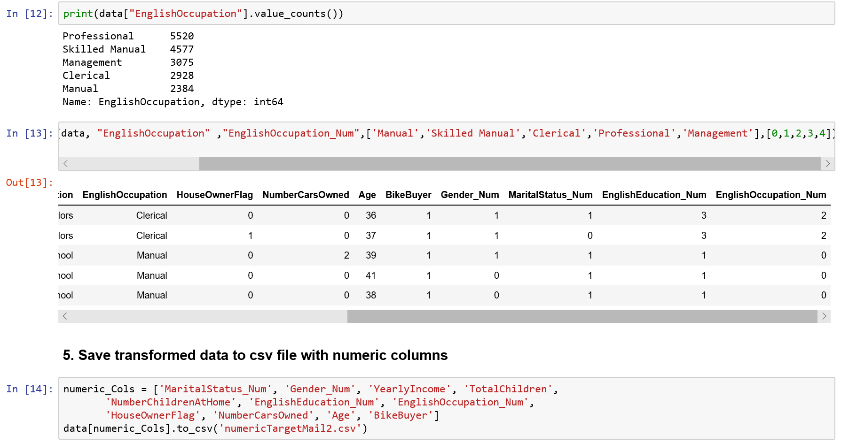
2.5 Tools: Python: Neural Net-prep: Datatype,Scale,Sklearn-canned,TensorFlow-custom
(special, extra) Data Prep for Neural Nets:
(use Python notebook:) Convert categorical/dates to numeric:
(use ICA06_BikeBuyer_NeuralNets_A_prep)
Select only desired features (ie columns)
Cast datatypes (eg. astype(int))
Transform categorical values into numerical values
Save dataframe into output-csv-file of numeric columns
For printout of run, see ICA06_BikeBuyer_NeuralNets_A_prep.html
Vince Davis – Alberta School of Business

Slide 25
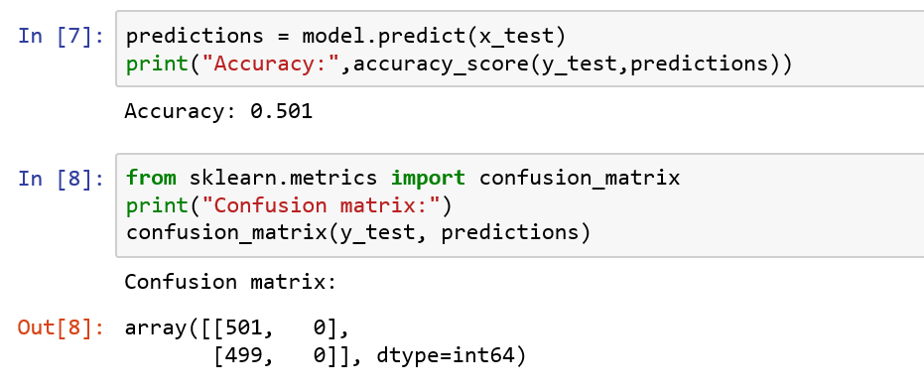
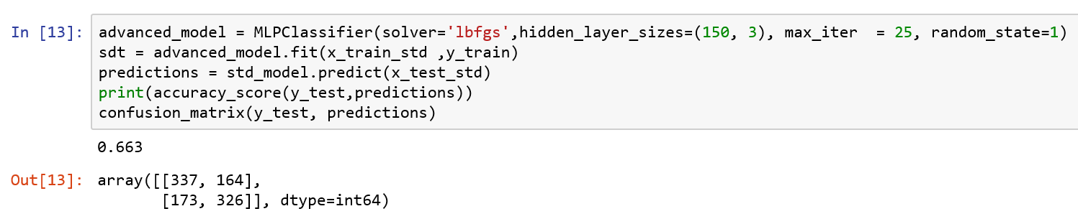
Prediction: How AI Neural Nets work:
Using Google TensorFlow/ Python in personal laptop
Neural Net (simple, using Sklearn’s “canned” proc):
(use ICA06_BikeBuyer_NeuralNets_B1_simple)
Split data into Train (17,848) and Test (1000) datasets
Use Sklearn’s MLP Classifier proc to do simple predictions (acc=.501)
Re-scale / standardize data
Re-Use Sklearn’s MLP Classifier proc to do simple predictions (acc=.663)
For printout of run, see ICA06_BikeBuyer_NeuralNets_B1_simple.html
Vince Davis – Alberta School of Business

Slide 26
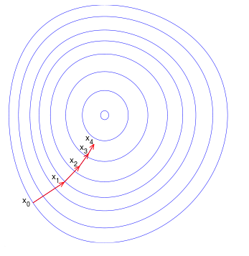
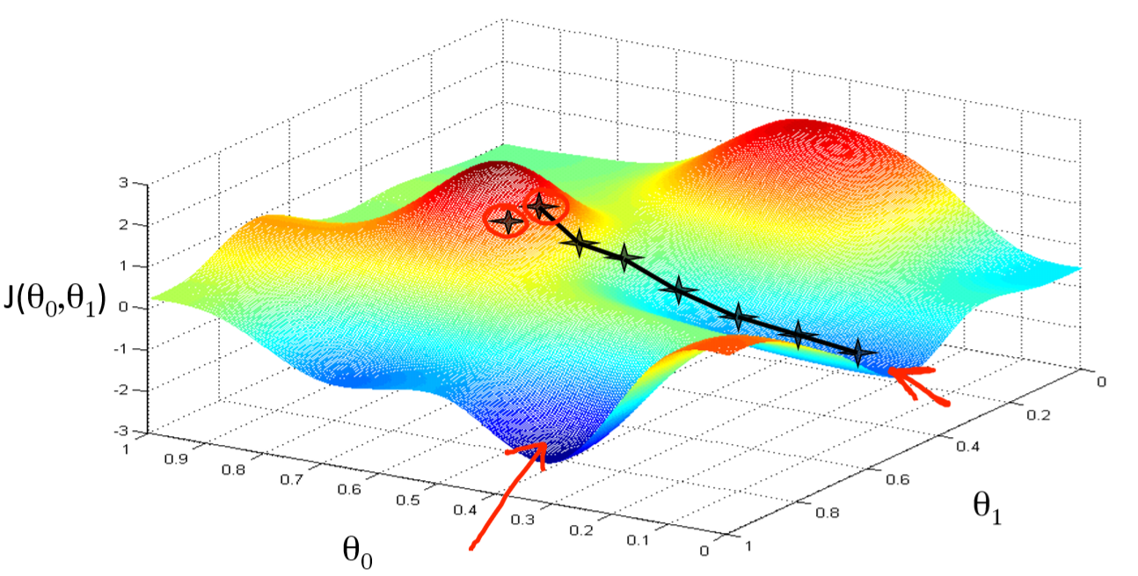
Neural Nets trained using Back Propagation
Eg. Google TensorFlow in DataBricks-cloud
Define: how many “Training Iterations”?
Initially, Neural Net has random internal weightings on all inter-connections.
When we train with 1st case (eg. Data-row 1 / 17,434: including correct answer):
-An algorithm adjusts the weightings to enable the net to “better” predict in the future.
After each subsequent training case:
-same algorithm tries to “move” the weightings “towards” a (possible) spot in the (11D) space where the net gives the correct answer to all cases. A common algorithm is “Gradient Descent”.
Loss-function(x3)
After all 17,434 cases have been applied once: That is ONE “Training Iteration”.
Applying all 17,434 cases again will yield more improvement: a 2nd iteration, 3rd, etc.
How many Training Iterations should be applied?
While-stop= Until “no further improvement” (ie Loss-function below a certain value)? Or perhaps Fixed-stop: 20?

Slide 27
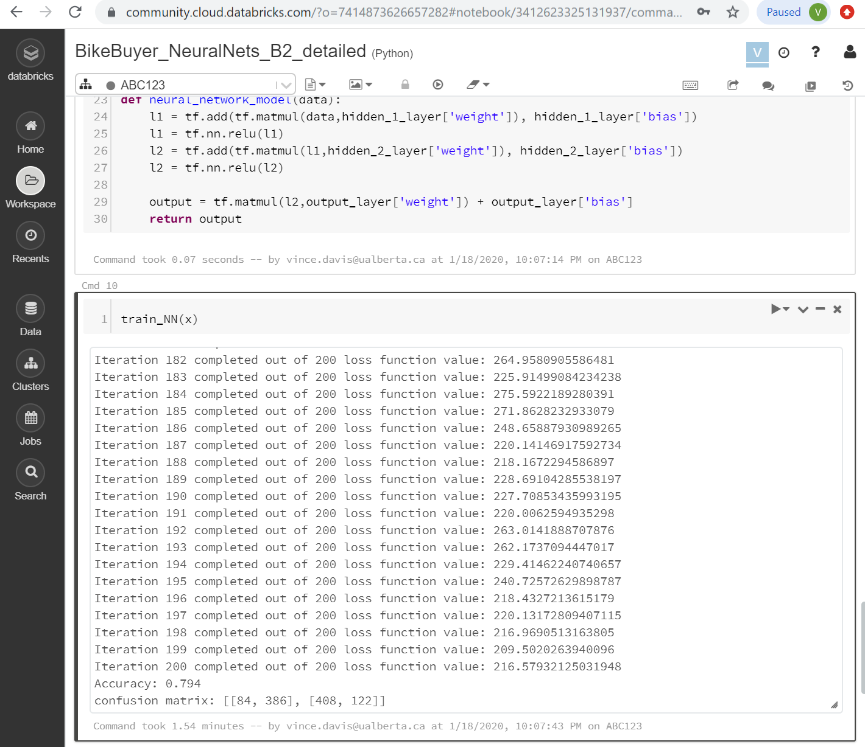
Prediction: How AI Neural Nets work:
Using Google TensorFlow/ Python in DataBricks (Cloud)
Neural Net (using Tensorflow and Custom proc):
(use ICA07_BikeBuyer_NeuralNets_B2_detailed)
With custom array and high iterations, accuracy = .794 !!
For printout of run, see ICA07_BikeBuyer_NeuralNets_B2_detailed.html
Vince Davis – Alberta School of Business

Slide 28
Course-Topics in MIS Predictive Analytics:
MIS412: Managerial Support Systems Descriptive Analytics (w. hands-on Asgn A):
Review: Navigation of Relational Data Models (SQL): Join, Group By, View
Optimizing Models: Snowflakes, Stars, Large-Central-Tables (eg. Csv)
OLAP: Pivot-Tables: Summarize, Slice, Drill-down, Cross-tab, Pivot
Tableau: (equivalent Join, View, Pivot-Tables Summarize, Cross-tab) Graphic Display
Python Dataframe: (equivalent SQL, Pivot, Cross-tab, Graphic Display)
Predictive Analytics (w. hands-on Asgn B & C):
SQL Data-Prep: View, Join, Group By, Add Columns: Summaries, Bins
Python Data-Prep: Datatypes, Bins, Handle Nulls/ Outliers/ High# Distinct/Unique
Mining Algs: Decision-Tree, Bayes, Cluster, Neural Net-ML: Split/ Train/ Test/ Apply
Tools: Python: Neural Net-prep: Datatype, Scale, Sk-learn-canned, TensorFlow-custom
Tools: MS-SSDT-client, MS-Azure-cloud, WeKa, DataBricks-cloud
Other Managerial Support Systems topics (w. Asgns C&D):
Text Mining / Web Mining
Knowledge Mgt (KM)
Group (Decision) Support Systems
Expert Systems / Recommenders
Robotics
Big Data/ IOT/ Map Reduce-Hadoop
What topic(s) should be added/enhanced for next year (Asgn C&D: Sep 2020)?
Text-mining (incl. graph-databases?)_______________________________________
Predictions on “Health-AHS” data? (incl. DNA markers?)____________
Quantum computers (incl. np-hard algorithms?)__________________________
Other Big Data/ IOT topics? (eg. AWS S3-files?)________________
Other? _________________________________________________________________
Vince Davis – Alberta School of Business

